Slide 1

BIG IDEAS FOR FY ‘25-26
July 1, 2026

Slide 2

Partner with the University of Michigan’s Center for Entrepreneurship
Collaborate with CFE to host events and raise awareness about DEGC as an outside resource for young entrepreneurs. We invite students, alumni, and connections to our events as one of CFE trek stops to educate people about the success of DEGC small businesses and why they should consider Detroit as a location to start their business.

Slide 3
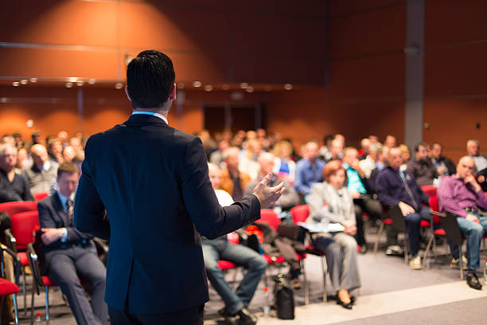


College Summit Event
Host an entrepreneurial event with local colleges, targeting students who are interested in starting their own business after graduation. Reach out to Wayne State, Eastern, the University of Michigan, Michigan State, etc, to connect with student-led business organizations and invite students to our summit to learn about DEGC. This educational event will raise awareness about DEGC’s work and Detroit’s growing economy.

Slide 4


